Slide 1

@maaretp
@LlewellynFalco

Slide 2
Developing a new feature

Slide 3

Developer

Slide 4
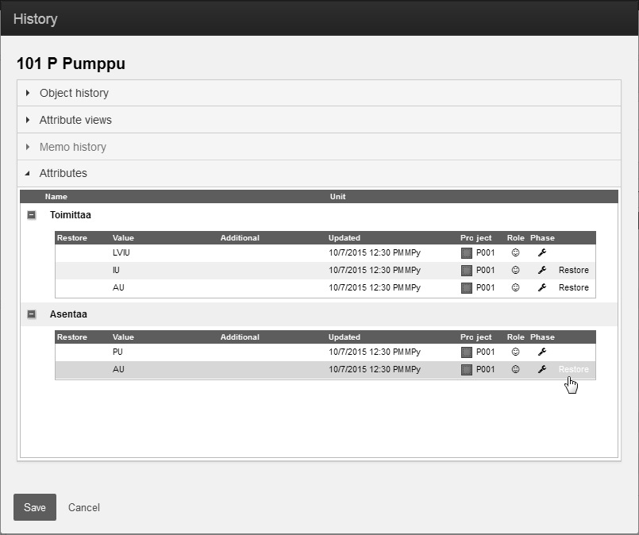

Slide 5
Tester

Slide 6
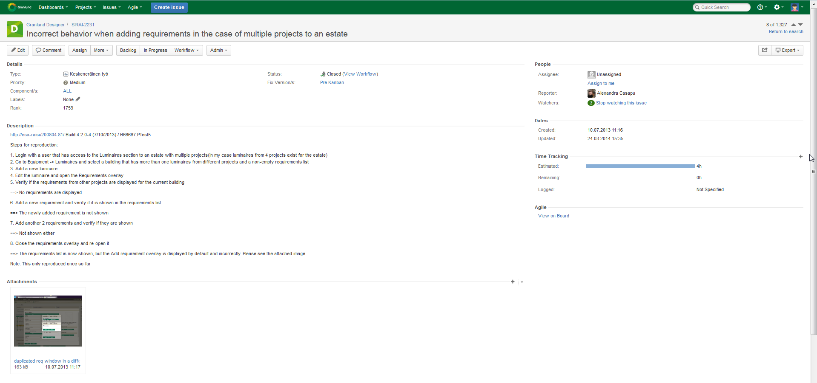

Slide 7
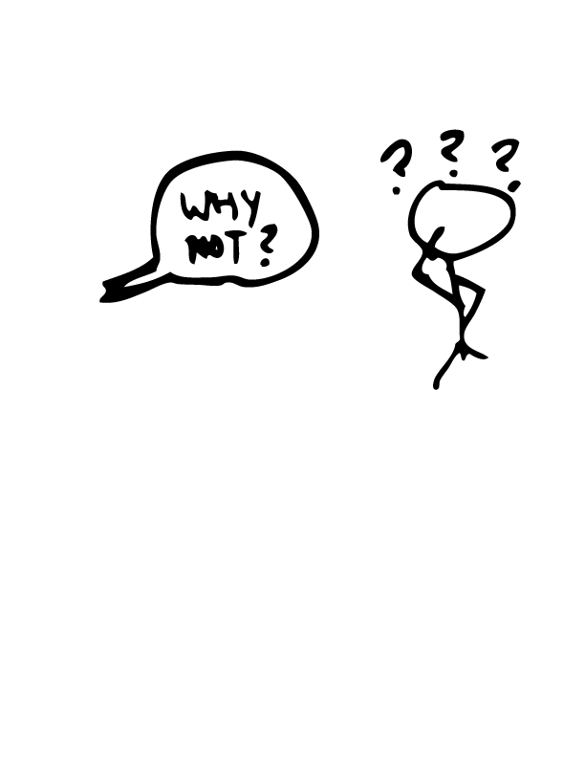
?!?%#

Slide 8
Except…

Slide 9
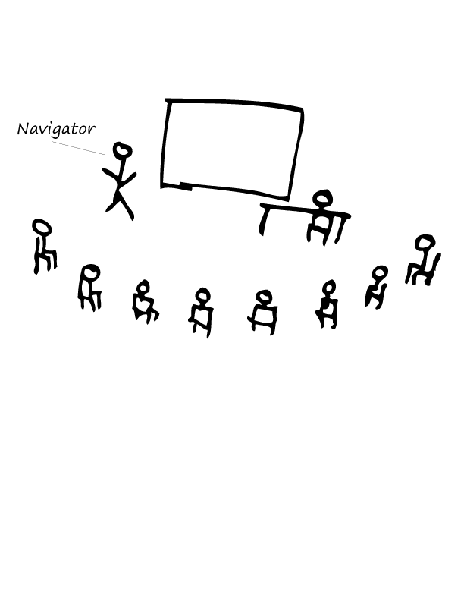
A day of mobbing

Slide 10
That would’ve been a nasty one to find later
* http://visible-quality.blogspot.fi/2015/09/my-first-full-day-of-mob-programming.html

Slide 11
Benefits of working together

Slide 12
Wasted Effort effort building wrong thing effort testing effort fixing

Slide 13
Time to deliver

Slide 14
Ego

Slide 15
Co-creation vs. Collaboration

Slide 16
Tales from Developer Tester Collaboration
Maaret Pyhäjärvi & Llewellyn Falco

Slide 17

1st session on unit testing
* http://visible-quality.blogspot.fi/2015/01/a-learning-journey-with-unit-tests-just.html

Slide 18
Invite trust

Slide 19
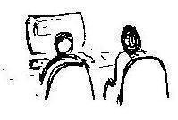
Strong Style Pairing
“For an idea to go from your head to the computer it must go though someone else’s hands”
*http://llewellynfalco.blogspot.fi/2014/06/llewellyns-strong-style-pairing.html

Slide 20


Farming vs. Hunting

Slide 21


“Look at me” Pairing

Slide 22
Make space for new ideas

Slide 23
Why are we having issues?

Slide 24
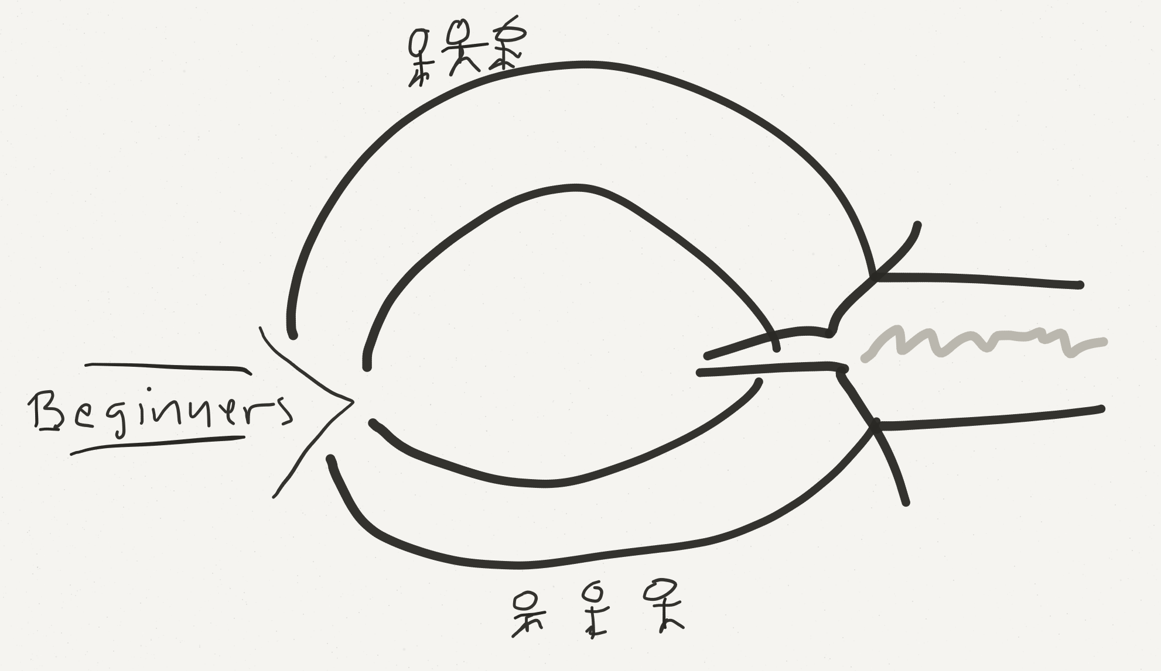
How we became how we are

Slide 25
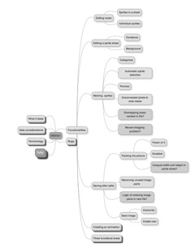
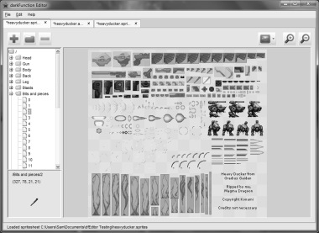
Exploratory Testing DFEditor

Slide 26
‘Obvious to you’ might be ‘special to me’

Slide 27
You can be active without taking over

Slide 28
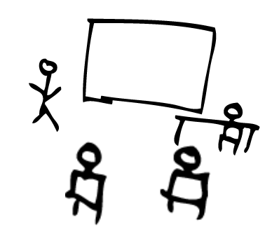

Testing Excel

Slide 29
Testers & Developers Think Differently

Slide 30
Developers excel in laziness

Slide 31
Your testers also know your users

Slide 32
What Testing Gives Us
Testing as performance
SPEC
FEEDBACK
REGRESSION
GRANULARITY
Unit Testing
GUIDANCE
UNDERSTANDING
SERENDIPITY
MODELS
Exploratory Testing
Testing as artifact creation
Notes:
This is what it is and what it could be. There’s a direction to it, not just statement of what it is.
Coaching is not just feedback, it’s pointing them to the right way.
EXPERIENCE (the verb) rather than facts ; emotions over facts. REACTIONS.
UNDERSTANDING – where you start (knowing the thing (code & environment), knowing the user, knowing the problems, knowing the developers (how to help them and what they do so that you can efficiently test), knowing the hackers (weird use cases outside common ‘have you tried reading it upside down’) , knowing all stakeholders, knowing the business priorities)

Slide 33
Why do this?
“It’s about getting the best (not the most)
out of everyone”

Slide 34
Quality

Slide 35
Quality

Slide 36
Learning's:
Some dev care about testing
Skilled tester exist
MindMaps are amazing
Remote desktop
Quality
Some testers are great product owners
Pairing & Mobbing
Testers don’t report everything
More powerful unit tests
Shortcuts & Cheats

Slide 37
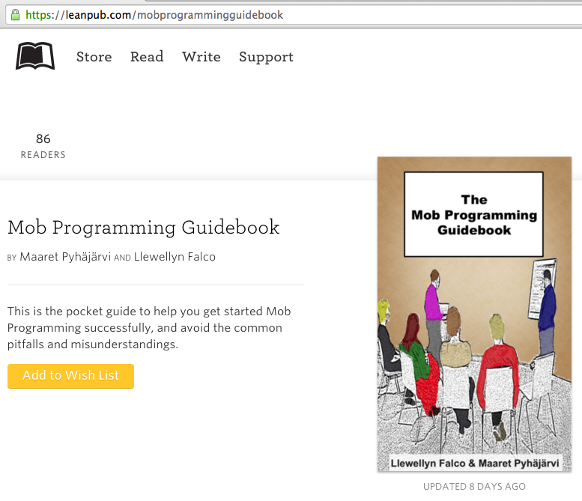
#MobProgrammingGuidebook

Slide 38
ROI of spending 1 hour a day
learning for a 1% increase
Output

Slide 39
ROI of spending 1 hour a day
learning for a 1% increase
5x (1 year)
Output
2x (6 months)
28 days

Slide 40

Thank you.
@maaretp
@LlewellynFalco
(please connect with us through Twitter or LinkedIn)

